Slide 1
Strategy Maps
A selection of editable strategy maps

Slide 2
Any intelligent fool can make things bigger and more complex. It takes a touch of genius – and a lot of courage – to move in the opposite direction
Albert Einstein

Slide 3
The Strategy Map
A Strategy Map is a diagram that describes how a company or organisation can create value by linking strategic objectives in a cause and effect relationship.
It is based on the four Balanced Scorecard Perspectives: Financial, Customer, Internal Processes and Organisational Capacity.
The key element of the Strategy Map is that it is linked to the ‘scorecards’ that monitor the progress towards the Strategic Objectives.
The ‘scorecards’ will include: metrics, targets for the metrics and strategic initiatives to drive performance towards achieving the objectives.

Slide 4
The Strategy Map
The Balanced Scorecard is a strategic planning and management method used to:
align business activities to a vision and strategy of an organisation
improve internal and external communications
monitor organisational performance against strategic goals.
The design of Balanced Scorecard concerns itself with:
the identification of a small number of financial and non-financial measures referred to as Perspectives
setting targets for the measures and then
measuring them on a regular basis to determine success or failure.

Slide 5
Templates

Slide 6
A classic generic Kaplan and Norton styled strategy map
Productivity Strategy
Growth Strategy
Financial Perspective
Long-Term Shareholder Value
Improve Cost Structure
Increase Asset Utilisation
Expand Revenue Opportunities
Enhance Customer Value
Customer Perspective
Customer Value Proposition
Price
Quality
Availability
Selection
Function
Service
Partnership
Brand
Product / Service Attributes
Relationship
Image
Internal Perspective
Operations Management Processes
Customer Management Processes
Innovative Processes
Regulatory and Social Processes
Supply
Production
Distribution
Risk Management
Selection
Acquisition
Retention
Growth
Opportunity Identification
R&D Portfolio
Design / Develop
Launch
Environment
Safety and Health
Employment
Community
Organisational Capacity
Human Capital
Information Capital
Organisational Capital
Culture
Leadership
Alignment
Teamwork

Slide 7
Private sector example with ‘strategic themes’
Financial Perspective
Increase Shareholder Value
Improve position in Defined Markets
Increase Profitability
Increase Revenue Streams
Customer Intimacy
Technology Driven
Operational Excellence
Customer Perspective
Improve Advisor Position
Improve Flexible Solutions
Improve Repeat Business Rate
Increase Added Value
Internal Perspective
Increase Knowledge Base Usage
Improve Resourcing Services
Improve Integrated Business Processes
Improve Cost Management
Strengthen 3rd Party Relationships
Improve Solution Processes
Organisational Capacity
Enhance Relationship Skills
Improve Operational Management Skills
Improve Solution Management
Improve Industry Knowledge
Enhance Career Planning

Slide 8
Public sector example with content and strategic themes
Customer & Stakeholder
Value to Taxpayer
Safe and Convenient Bus Services
On Time as Promised
Financial
Balance Budget
Support Business and Commerce
Create Business Cases and Secure Funding
Lower Cost of Bus Transportation Services
Internal Processes
Relationship Management
Innovation
Operational Excellence
Easy to do Business With
Drive Innovation in New Transport Systems
Deliver World Class Bus Services
Streamline Regulatory Approval Processes
Improve Sustainability of Communities
Accelerate Economic Development through Route Investment
Develop and Introduce New Transport Technology
Provide Cost Effective Solutions
Optimise Availability of Busses
Open and Frequent Communication to Impacted Customers
Improve All Aspects of Bus Safety
Optimise Planning of Bus Stop Position and Construction
Understand New Route Needs (and Old)
Organisational Capacity
Highly Skilled Bus Drivers
Empowered Customer Service Agents
Integrated Knowledge Management Systems

Slide 9
Basic Strategy Map Background
Financial
Customer
Processes
Capacity

Slide 10
Basic empty template with oval objectives
Financial Perspective
What are our most important financial outcomes?
Customer Perspective
How should we appear to customers?
Process Perspective
At what do we need to excel to fulfill customer expectations?
Organisational Capacity Perspective
How will we sustain our ability to improve?

Slide 11
Empty frame with vision, mission and core values
Vision:
Mission:
Financial
Customer
Internal Processes
Organisational Capacity
Core Values:

Slide 12
Empty frame with strong colours
Vision
Financial
Customers
Internal Processes
Organisational Capacity
Core Values:

Slide 13
Multi Coloured with Branding
Financial
Improve Revenue
Customer
Improve Marketing
Process
Improve Processes
Acme Strategy Map
Capacity
Improve Knowledge

Slide 14
An integrated strategy map
Vision | Transforming people’s lives positively through an interconnected information society
Purpose | We will build a connected society that enhances socio-economic progress, embraces everyone and does not come at the cost of our planet.
Strategic Priorities | Content Partnerships | Customer Service | Brand Awareness
Strategic Results | Strong supply chain for content and information services, exclusive agreements | Clarity in offering that surpasses anything in the market today, best user interface | Reinvigorated brand based on successes, to attract a wider and younger audience
Strategic Objectives | KPIs | Targets | Projects
Financial | Net profit Operating costs Revenue in target markets | ↑ 5% per year ↓ 3% per year ↑ 12% per year | Implement new financial accounting system Simplify billing operations Competitive end user requirements market studies for new UK regions “Improve the Offering” two year programme Create improved offering selection process Hook into ‘Improve the Offering’ programme Training programme for new offerings and user interface Product and marketing training programme 2 year content supply agreements Technology improvement programme including data centre upgrade
Customer | % Market share index % Customer satisfaction index % Focus group user index | ↑ 3% per year 85% this year > 90% each focus session
Internal Processes | New products as % of sales Brand awareness score Cost efficiency index | 12% this year ↑ 5% per year > 90% every reporting period
Organisational Capacity | Employee development plans Technology training index Supply chain efficiency index | 95% in place 90% efficient 95%
Customer Focus - Integrity - Quality - Helpfulness - Community - Efficiency
Increase Revenue
Increase Profitability
Decrease Operating Costs
Improve Clarity of Offering
Improve Market Perception
Improve Customer Satisfaction
Improve Offering Selection
Improve Information Services
Improve Stock Reliability
Improve Cost Control
Improve Knowledge and Skills
Improve Technology
Improve Supply Chain

Slide 15
The strategy map element of the integrated strategy map
Transforming people’s lives positively through an interconnected information society
A connected society that enhances socio-economic progress, embraces everyone and does not come at the cost of our planet
Content Partnerships | Brand awareness | Customer Service
Financial
Customer
Internal Processes
Organisational Capacity
Honesty - Integrity - Helpfulness - Community - Efficiency
Increase Profitability
Increase Revenue
Decrease Operating Costs
Improve Clarity of Offering
Improve Market Perception
Improve Customer Satisfaction
Improve Offering Selection
Improve Information Services
Improve Stock Reliability
Improve Cost Control
Improve Knowledge and Skills
Improve Technology
Improve Supply Chain

Slide 16
Rectangular objectives rather than ovals
Mission:
Company Name
Vision:
Strategic Themes
Theme One
Theme Two
Theme Three
Financial
Strategic Objective 1
Strategic Objective 2
Strategic Objective 3
Customer
Internal
Capacity

Slide 17
A different approach (does not lend itself to causal relationships)
Vision: Mission:
Financial
Customer
Internal
Capacity

Slide 18
A Radical approach
Financial
This circular version is occasionally used to focus everything towards the mission and strategy, as a rally-call it works well. However it lacks in its ability to present causal linkages
Tesco used this approach during their ‘Every Little Helps’ campaign
Financial Objective 1
Mission
Internal Objective 1
Mission
Vision
Customer
Internal
Customer Objective 1
Learning Objective 1
Learning

Slide 19
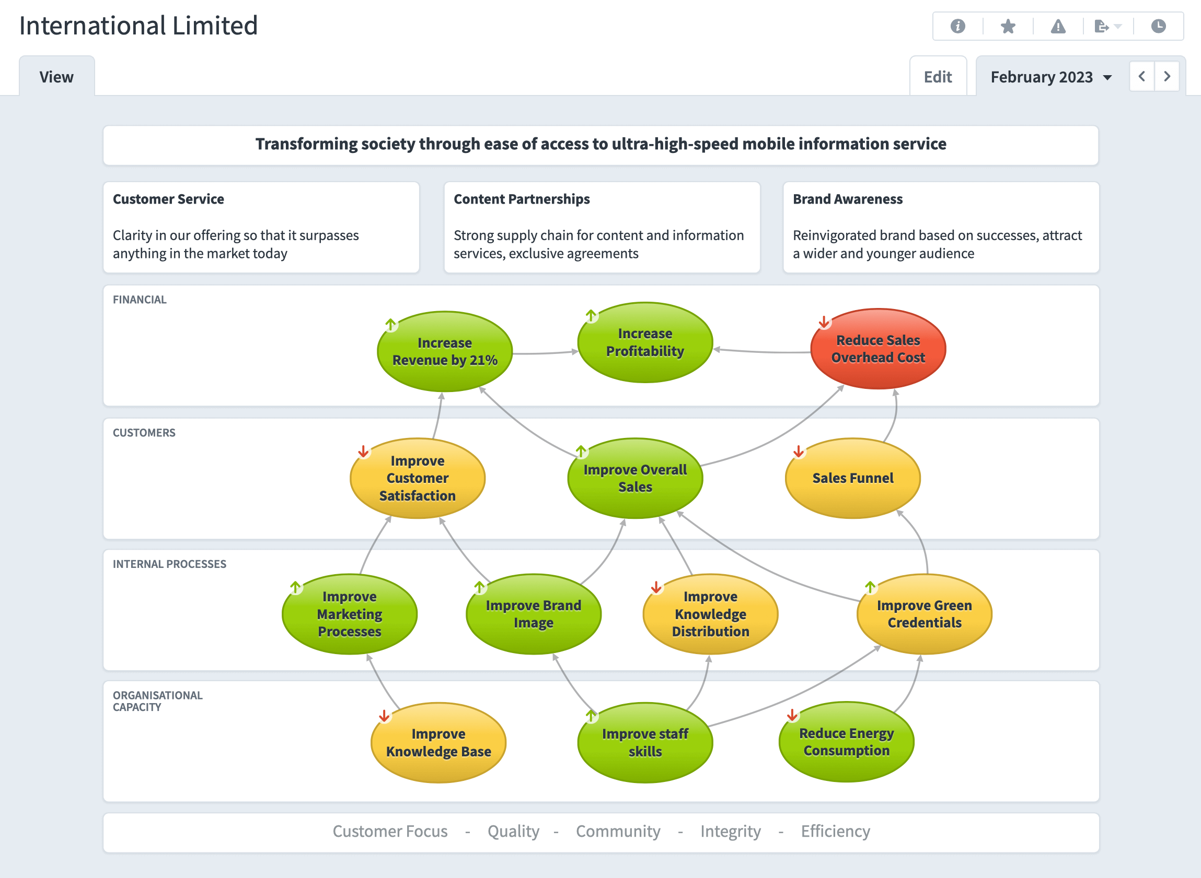
Output from Spider Impact
Using PowerPoint to create a strategy map is a good first step. The application will allow you to create any visual representation that you might require.
However, PowerPoint will not update the data automatically next month, or the month after that.
Generating a strategy map using an application like Spider Impact is easy and will ensure your data is always up to date.

Slide 20
Using Spider Impact to manage your balanced scorecard and strategy maps
Software is not required to implement a Strategy Map or Balanced Scorecard, but it really helps. A good software tool will allow user to:
create meaningful Strategy Maps with minimum fuss
organise key metrics in a meaningful way
display data and combinations of data
provide management teams with a clear business overview
allow users to input data easily and frequently
Provide the means to ‘drill down’ to the underlying data should the need arise to question a specific activity
Intrafocus recommends Spider Impact to those companies that want to take a structured approach to rolling out Strategy Maps and Balanced Scorecards

Slide 21
Thank You
Notes:
© Intrafocus Limited 2018. Please do not copy without permission

